Slide 1
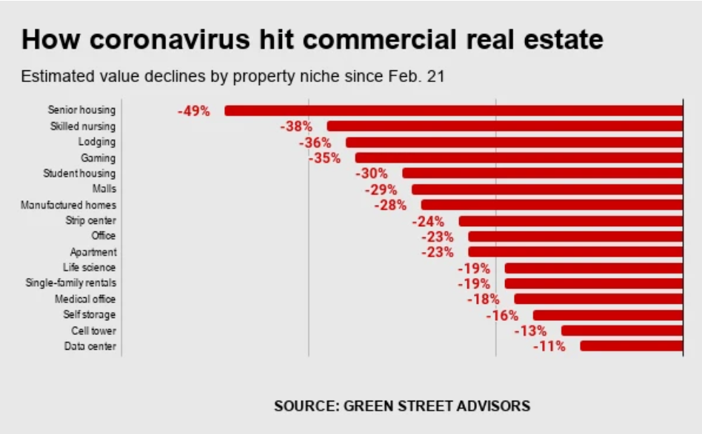

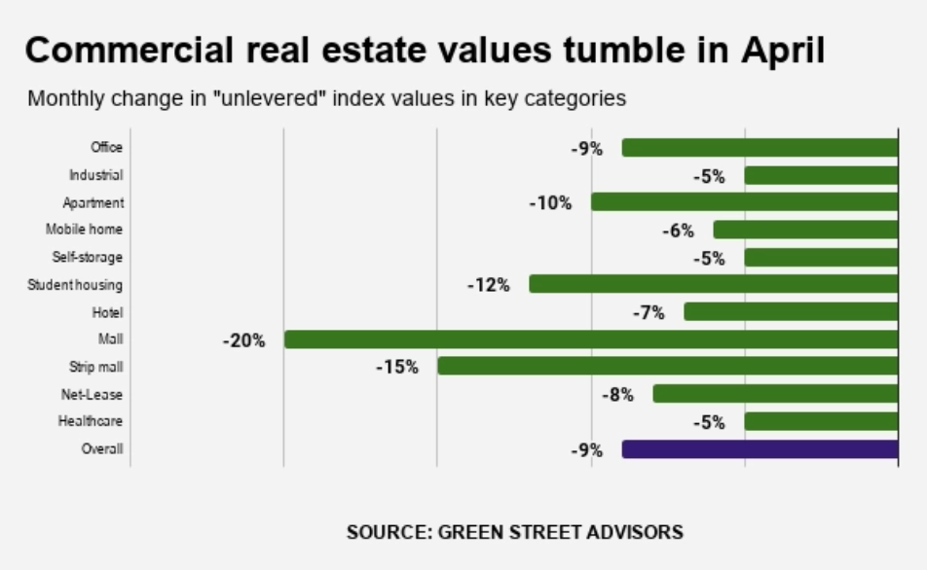
REAL ESTATE AND COVID-19
“Coronavirus puts real estate ‘on brink of collapse
If not immediately addressed, this cycle cascades into chaos”
Tom Barrack
Founder and Executive chairman of REIT Colony Capital Inc.

